Slide 1

building
THE FOUNDATIONS
for patient SAFETY
collaboration
communication
education
Medication Safety

Slide 2

Overview of Presentation
Patient safety initiative
Definitions
Medication errors problem/frequency/cost
Stages of medication delivery and errors
Practice models on medication safety
  Prescribing/ordering
  Dispensing
  Administration
  Monitoring
Resources

Slide 3
Patient Safety Initiative
The Patient Safety Steering Committee is an interdisciplinary collaborative spearheaded by the FHA and includes 14 organizations. The Committee has taken a leadership role in providing guidance, direction and priorities related to initiatives related to patient safety, focusing on medical error.

Slide 4

Practice Model Guidelines
The Patient Safety Steering Committee has developed four practice model guidelines in medication safety.
These guidelines do not constitute the standard of care and are not intended to be the only practice methods for use.
Building
Foundations

Slide 5
Practice Model Guidelines
Developed so all hospitals would be able to implement them regardless of their size, level of automation, and location.
Intended to be used by the health care team in a collaborative approach so that all aspects and caregivers are involved in the improvement process.
These guidelines should be tailored to each organization’s unique structure, policies, and resources so that the best results can be achieved.
They are based on current literature and research related to the particular practice.

Slide 6
Medication Error Definition
"A medication error is any preventable event that may cause or lead to inappropriate medication use or patient harm while the medication is in the control of the health care professional, patient, or consumer. Such events may be related to professional practice, health care products, procedures, and systems, including prescribing; order communication; product labeling, packaging, and nomenclature; compounding; dispensing; distribution; administration; education; monitoring; and use." (NCCMERP)

Slide 7
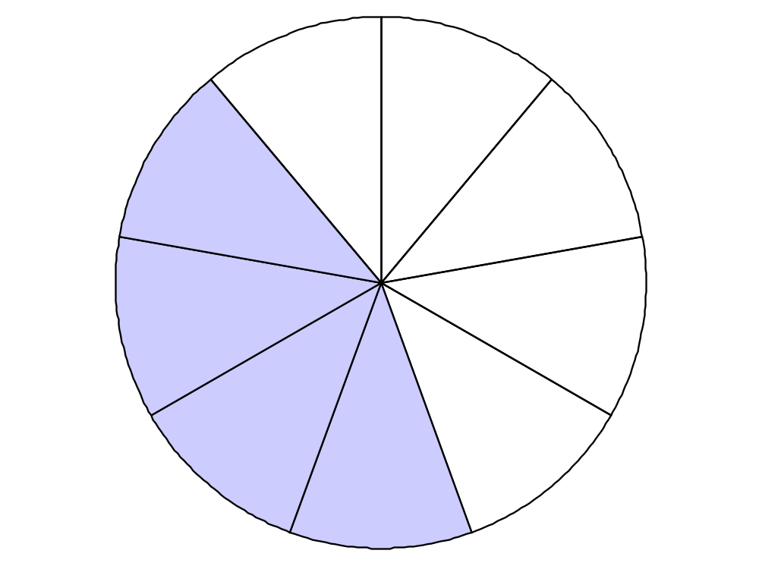
NCC MERP Index for Categorizing Medication Errors
Category I:
An error occurred that may have contributed to or resulted in the patient’s death
Category A:
Circumstances or
events that have the
capacity to cause error
Category H:
An error occurred that required intervention necessary to sustain life
Category B:
An error occurred but the error did not reach the patient (An “error of omission” does reach the patient)
Category G:
An error occurred that may have contributed to or resulted in patient harm
Category C:
An error occurred that reached the patient but did not cause patient harm
No Error
Error, No Harm
Error, Harm
Error, Death
Category F:
An error occurred that may have contributed to or resulted in temporary harm to the patient and required initial or prolonged hospitalization
Category D:
An error occurred that reached the patient and required monitoring to
confirm that it resulted in no harm to the patient and/or required intervention to preclude harm
Category E:
An error occurred that may have contributed to or resulted in temporary harm to the patient and required intervention

Slide 8

Medication Error Problem
Medication errors are most common type of nursing error
Second most common JCAHO sentinel event
Second most common error in physician offices

Slide 9

Why Medication Error Rates Vary
The studies define ADE differently
The narrow definitions have a smaller rate per 100
The broader the definition the higher the error rate found

Slide 10
Medication Error Frequency
Rate of 6.5 ADEs per 100 admissions (Bates, JAMA,1995)
The Harvard Medical Practice Study found 3.7% of patients had an adverse event
19% were drug complications
ADE in 2.43 admissions per 100 (Classen, JAMA.277:301-306, 1997)
Lazarous performed meta-analysis in 1998
ADR rate was 6.7%
Estimated ADR’s are between the 4th and 6th leading cause of death in US

Slide 11

Frequency at Children’s Hospitals
Children at risk because of calculation errors
  study at two children’s hospitals
  rate of 4.9 and 4.5 per 1000 orders

Slide 12


The Cost of Errors is High!!
One study found 2% of all patients had a preventable ADE
Resulting in an increased LOS of 4.6 days
With average increased hospital cost of $4,700 per admission (Bates, David, 1995)

Slide 13
Stages where errors occur
Medication errors can be broadly categorized into four phases.
Medication error prevention strategies can be built around phases with high problem rates.

Slide 14
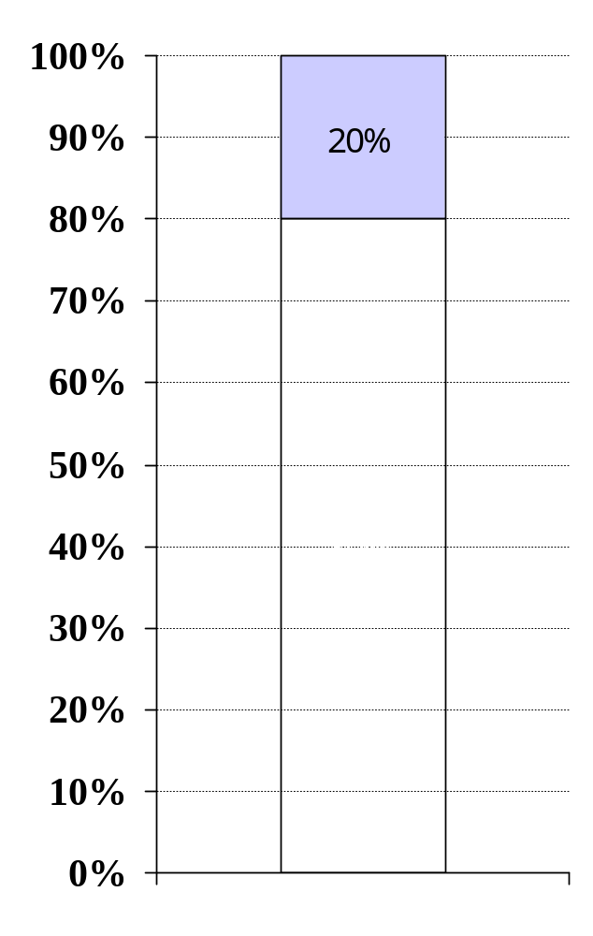
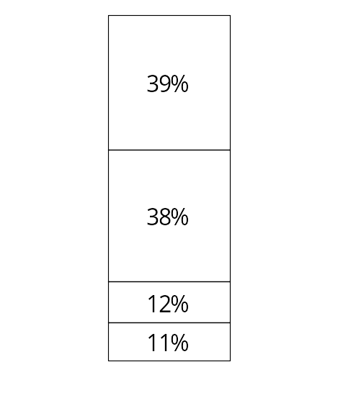
Medical Errors by Type
Medication
Errors
Ordering/
Prescribing
Administration
Dispensing
Other
Transcribing
Leape, et al

Slide 15
Practice Models
Phase 1- Ordering/Prescribing
Phase 2- Dispensing
Phase 3- Administration
Phase 4- Monitoring

Slide 16

Phase 1- Ordering/Prescribing
Have essential patient information readily available to those involved in the ordering/prescribing of medications. This includes diagnoses, allergies and sensitivities, lab values, current medication regimens and any other key information.

Slide 17
Phase 1- Ordering/Prescribing
Prior to writing any medication order, document patient allergies in a conspicuous area of the physician’s order form. Document patient allergies on all pages of other applicable forms e.g. MAR, pharmacy profiles, Kardex, etc.
Have essential medication references (such as PDR, Nurses Drug Handbook, MicroMedex, etc.) readily available on the units where medications are ordered/prescribed.

Slide 18
Phase 1- Ordering/Prescribing
Review formulary in collaboration with the Pharmacy and Therapeutics Committee of the medical staff to limit, where appropriate, the number of therapeutically and generically equivalent products.
Assess variability in medication administration systems and standardize processes where possible, such as medication administration times.

Slide 19
Phase 1- Ordering/Prescribing
Develop special procedures/protocols for the use of “high risk” medications such as heparin, insulin, chemotherapy, concentrated electrolyte solutions etc.
Include medication safety in staff orientation and competency programs.

Slide 20
Phase 1- Ordering/Prescribing
Develop protocols for verbal orders to assure that:
  Ordering/prescribing practitioners must be identified
  Patients must be clearly identified
  Verbal orders must be clear and concise
  Verbal orders from on-site practitioner are taken only in emergencies
  No verbal orders are taken for chemotherapy
  All verbal orders are repeated for verification

Slide 21
Phase 1- Ordering/Prescribing
Include all elements as part of an inpatient order:
  Full name of medication (avoid abbreviations and acronyms)
  Strength/Concentration
  Dose
  Route
  Frequency/Rate
Use metric system only

Slide 22
Phase 1- Ordering/Prescribing
Avoid abbreviations:
Spell out “units”. Do not use “u”.
Spell out medication name. Avoid abbreviations and acronyms.
Do not use any abbreviation for “daily”, “every other day”, or “four times daily”
Write out the word Discharge” and “Discontinue”. Do not use the abbreviation “DC”.
Use leading zeros before a decimal point e.g. 0.2 mg.
Do not use trailing zeros e.g. do not write 2.0 mg.

Slide 23
Phase 1- Ordering/Prescribing
Standardize times of administration of medications where possible.
Order medication by total dose required and not by volume, number of ampules or number of tablets.
Use dosing charts and dosing formulas, when appropriate.

Slide 24
Phase 1- Ordering/Prescribing
Develop policies that prohibit the use of potentially confusing orders such as “resume same medications” or “resume pre-op medications”.
Develop policies/procedures that address order legibility and clarification. Track and trend patterns and evaluate through peer review committees.
Implement a performance improvement system for medication safety ordering/prescribing practices

Slide 25

Phase 2- Dispensing
Ensure the immediate availability of appropriate and current drug reference texts and/or on-line resources to pharmacy personnel.

Slide 26
Phase 2- Dispensing
Ensure that essential patient information, such as allergies, age, weight, current diagnoses, pertinent lab values, and current medication regimen, is available to the pharmacist prior to the dispensing of a new medication order. If information is not available on-line, develop pharmacy profile data to include essential patient data.
Require that any order that is incomplete, illegible, or otherwise questionable be clarified using an established process for resolving questions. This applies to manual and automated systems.

Slide 27
Phase 2- Dispensing
Create an environment for the dispensing area that minimizes distractions and interruptions, provides appropriate lighting, air conditioning/air flow, safe noise levels, and includes ergonomic consideration of equipment, fixtures, and technology.
Utilize the unit-dose system to the fullest extent possible, even if extemporaneous packaging of medications, not already available in unit-dose form, is required.

Slide 28
Phase 2- Dispensing
Dispense dosage units in a ready-to-administer form, whenever possible (e.g., prefilled syringes, premixed IV solutions, etc.). Ensure that prefilled syringes have appropriate route noted and, if possible, use non-interchangeable connections to prevent the inadvertent administration by another route e.g. oral, nasogastric, or intrathecal.

Slide 29
Phase 2- Dispensing
Dispense single-dose vials and ampules rather than multidose vials.
Dispense only pediatric vials/ampules for pediatric units and adult vials/ampules for adult units. Do not mix pediatric and adult doses on units.

Slide 30
Phase 2- Dispensing
Require that all mathematical calculations for neonatal and pediatric dilutions, parenteral nutrition solutions, and other compounded pharmaceutical products be double-checked by a pharmacist.
Require that a second pharmacist double-check the accuracy of order entry and dose calculations for all orders involving antineoplastic agents. Determine other high risk drugs dispensed in your facility that require double checking.

Slide 31
Phase 2- Dispensing
Review the appropriateness of floor-stock medications. Eliminate dangerous products such as concentrated potassium chloride injection and lidocaine 2% 50-ml vials. Consider using automated dispensing devices such as Pyxis®, Acudose®, or others to increase security and accountability of necessary medications stocked in patient care areas if not currently in use and ensure such units are set up and managed properly in order to realize safety and security benefits.

Slide 32
Phase 2- Dispensing
Appropriately label all dispensed medications to include medication name, dose to be administered, dosage form, route, special storage requirements, lot number or batch number if applicable, expiration date, and all other applicable warnings. Compare original order, order label, and medication container for accuracy.

Slide 33
Phase 2- Dispensing
Establish procedure(s) whereby proposed changes in packaging/labeling, concentration, etc. are reviewed prior to being implemented, to reduce error potential. Notify users, such as anesthesia, emergency department, and critical care staff, of any changes in packaging/labeling and/or concentration of products used. This may occur due to changes in purchasing contracts, new drug concentrations, or product availability.

Slide 34
Phase 2- Dispensing
Use standard concentrations for the administration of high-risk medications (e.g. heparin, aminophylline, lidocaine, dopamine, insulin, morphine, etc.) Many of these medications are commercially available as premixed infusions.
Publicize and enhance the awareness of look-alike and sound-alike medications. Use warning signs, to help differentiate medications from one another, especially when confusion exists between or among strengths, similar looking labels, or similar sounding names.

Slide 35
Phase 2- Dispensing
Separate look-alike and sound-alike medications in pharmacy dispensing areas or consider repackaging or using different vendors.
Carefully review and consider the significance of pharmacy computer system warnings/alerts for drug interactions, dosage range, allergy, and other warnings so as not to become desensitized to these warnings/alerts.

Slide 36
Phase 2- Dispensing
Require that all investigational drugs be dispensed by the pharmacy and that pharmacy, medical and nursing personnel are knowledgeable of the medication’s pharmacology, administration guidelines, potential adverse effects, proper monitoring techniques and storage requirements.

Slide 37

Phase 3- Administration
Ensure that essential patient information, including allergies, age, weight, current diagnoses, relevant lab values and current medication regimen, is available.
Ensure the immediate availability of appropriate and current drug reference texts and/or online resources to those who administer medication.

Slide 38
Phase 3- Administration
Those who administer medications should be knowledgeable about the drug’s indications, precautions, contraindications, potential adverse reactions, interactions, and proper method of administration.
Require that any order that is incomplete, illegible, or otherwise questionable be clarified using an established process for resolving questions prior to administration of the medication.

Slide 39
Phase 3- Administration
Verify the dispensed medication for any new medication order with the original prescriber’s order and Medication Administration Record (MAR) to ensure that it is the correct medication for administration.
Require a Medication Administration Record (MAR) reconciliation process be conducted by pharmacists and nurses to ensure investigation and resolution of any differences in interpretation of physician orders.

Slide 40
Phase 3- Administration
Provide as much as possible, for a pharmacist’s review of non-emergent and non-urgent medication orders prior to administration of a first dose of medication to a patient.
Note both the brand and generic drug name on the Medication Administration Record (MAR).

Slide 41
Phase 3- Administration
Administer only medications that have been fully labeled with medication name, dose to be administered, dosage form, route, special storage requirements, expiration date, and all other applicable warnings.
Create an environment for administration that minimizes distractions and interruptions, provides appropriate lighting, safe noise levels, and includes ergonomic consideration of equipment, fixtures, and technology.

Slide 42
Phase 3- Administration
Utilize a standard medication administration time schedule, if appropriate. Educate nursing staff on how and when to incorporate newly started medication orders safely into the standardized schedule.
Maintain medication in its unit-dose package until the point of actual administration.

Slide 43
Phase 3- Administration
If a mathematical calculation of a dose is necessary, have a second nurse verify the calculation.
Ensure that nursing staff receives adequate education on the operation and use of devices and equipment used for medication administration (e.g. infusion pumps, PCA pumps, syringe pumps, etc.)
Have another nurse double-check infusion pump settings when critical, high-risk drugs are infused.

Slide 44
Phase 3- Administration
Confirm all of the “rights” prior to administering a medication (right patient, right drug, right dose, right dosage form, right route, right time and right education).
Educate patients about their role in taking medications and questions they should ask. Develop and document patient education.

Slide 45
Phase 3- Administration
Do not administer multiple dosage units of any drug without double-checking for accuracy and appropriateness of the dose, e.g. an order that might require the administration of several tablets, capsules, single dose vials, etc. as one dose.
Document all medications immediately after administration.

Slide 46
Phase 3- Administration
Never borrow medications from another patient’s medication cassette.
Establish policies/procedures for double-checking that includes verification of the original order, calculation, appropriateness, patient information and actual prepared medication.

Slide 47



Phase 4- Monitoring
To the fullest extent possible, monitor patients receiving medications with a narrow therapeutic index/critical dose, e.g. digoxin, theophylline, heparin, warfarin, phenytoin, lithium, carbamazepine, etc. If automated systems are not available, develop systems and processes to address such drugs.

Slide 48
Phase 4- Monitoring
Review all out-of-therapeutic-range serum drug levels reported by the laboratory for patients throughout the hospital and intervene as appropriate. Establish notification times for alerts on critical lab values. If automated systems are not available, develop systems and processes to address critical lab values related to medication administration.

Slide 49
Phase 4- Monitoring
Establish protocols and guidelines for use with critical and/or problem-prone medications to help optimize therapies and minimize the possibility of adverse events. Integrate “triggers” to indicate the need for additional clinical monitoring.

Slide 50
Phase 4- Monitoring
Develop nonpunitive processes for reporting medication errors, near misses, and adverse drug reactions. Track, trend, and review these events as part of a regularly scheduled interdisciplinary committee such as the Pharmacy and Therapeutics Committee. Focus on implementing changes to improve systems and processes.

Slide 51


Key Learnings
Medication errors account for a large percentage of medical errors.
Existing research and resources provide improvement strategies for today.
Systems and processes need to be reviewed for changes.
Change must involve a team approach.
Change must involve the patient

Slide 52

Resources
American Pharmaceutical Association- (www.aphanet.org)
American Society of Heath-System Pharmacists-(www.ashp.org)
Enhancing Patient Safety and Errors in Healthcare (www.mederrors.com)
National Coordinating Council for Medication Error Reporting and Prevention (www.nccmerp.org)

Slide 53
Resources
National Patient Safety Foundation (www.npsf.org)
The Institute for Safe Medication Practices- (www.ismp.org)
U.S. Pharmacopoeia (USP) (www.usp.org)
U.S. Food and Drug Administration MedWatch (www.fda.gov/medwatch)
Institute for Healthcare Improvement- (www.ihi.org)

Slide 54
Resources
Florida Patient Safety Steering Committee Practice Models for Medication Safety (www.fha.org)
JCAHO Sentinel Event Alert (www.jcaho.org)
Breland BD Strategies for the Prevention of Medication Errors. Hospital Pharmacy Report 2000; Vol. 14 No 8; pp 56-65.

Slide 55
Resources
Medication Errors edited by Michael Cohen (1999) from ISMP
Hospitals and Health Networks (www.hhnmag.com) Medication Safety Briefs
DrugInfoNet (www.druginfonet.com)
Safe Medication (www.safemedication.com)

